Slide 1
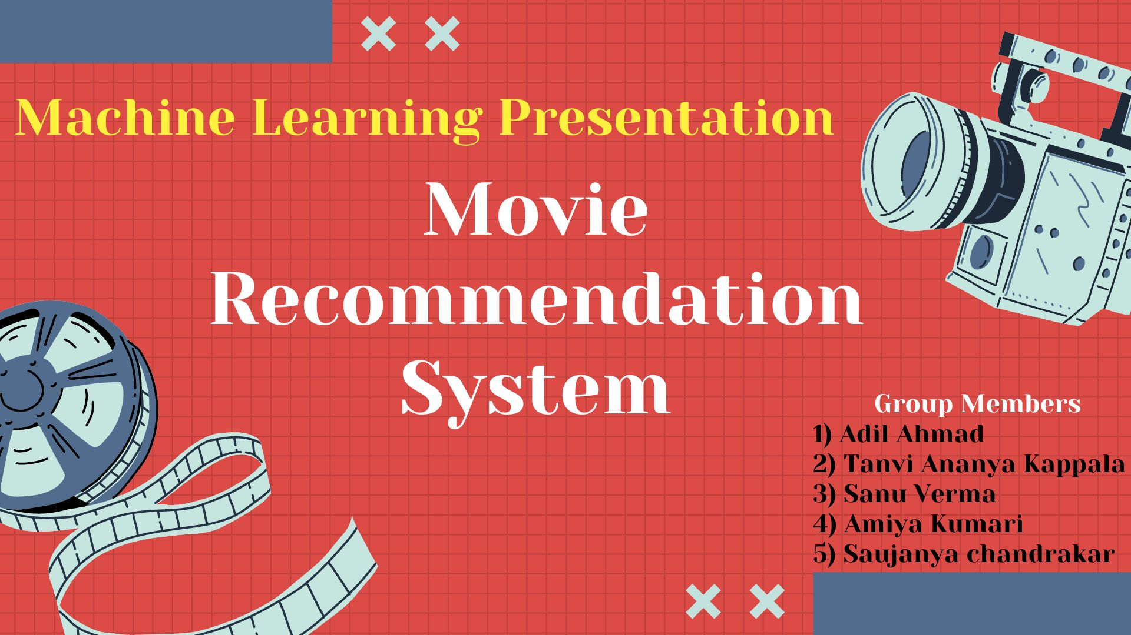

MOVIE RECOMMENDATION SYSTEM USING ML
(Permanently Affiliated to University of Mumbai)
Name of Group Members:
Noaman Kaysingwala – 625
Shivshankar Sahu – 653
Piyush Save – 654
Mohd. Arshan Shaikh - 657
Guided By:
Prof. S.K. Sabnis Sir

Slide 2
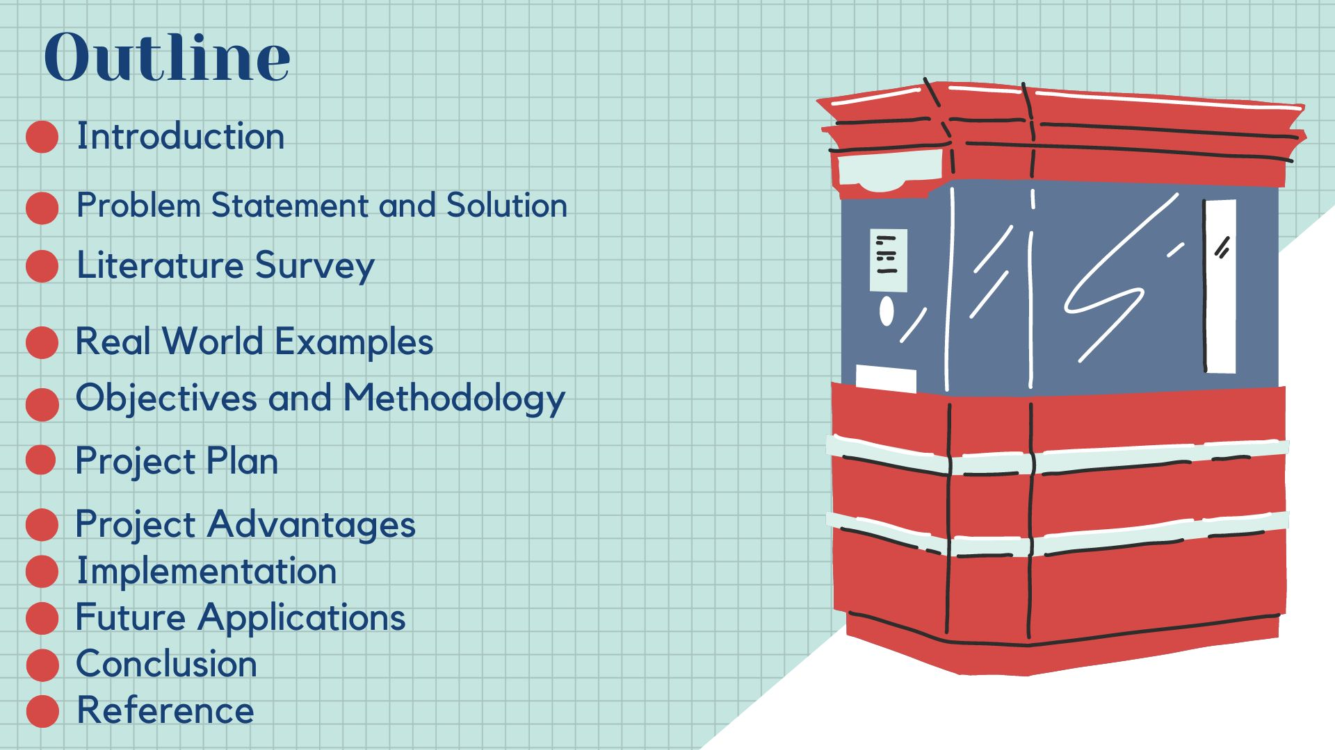
OUTLINE
(Permanently Affiliated to University of Mumbai)
Introduction
Problem Statement
Real World Example
Objectives
Requirements
Methodology
Project Plan
Project Advantages 9.Conclusion 10.Reference
s

Slide 3
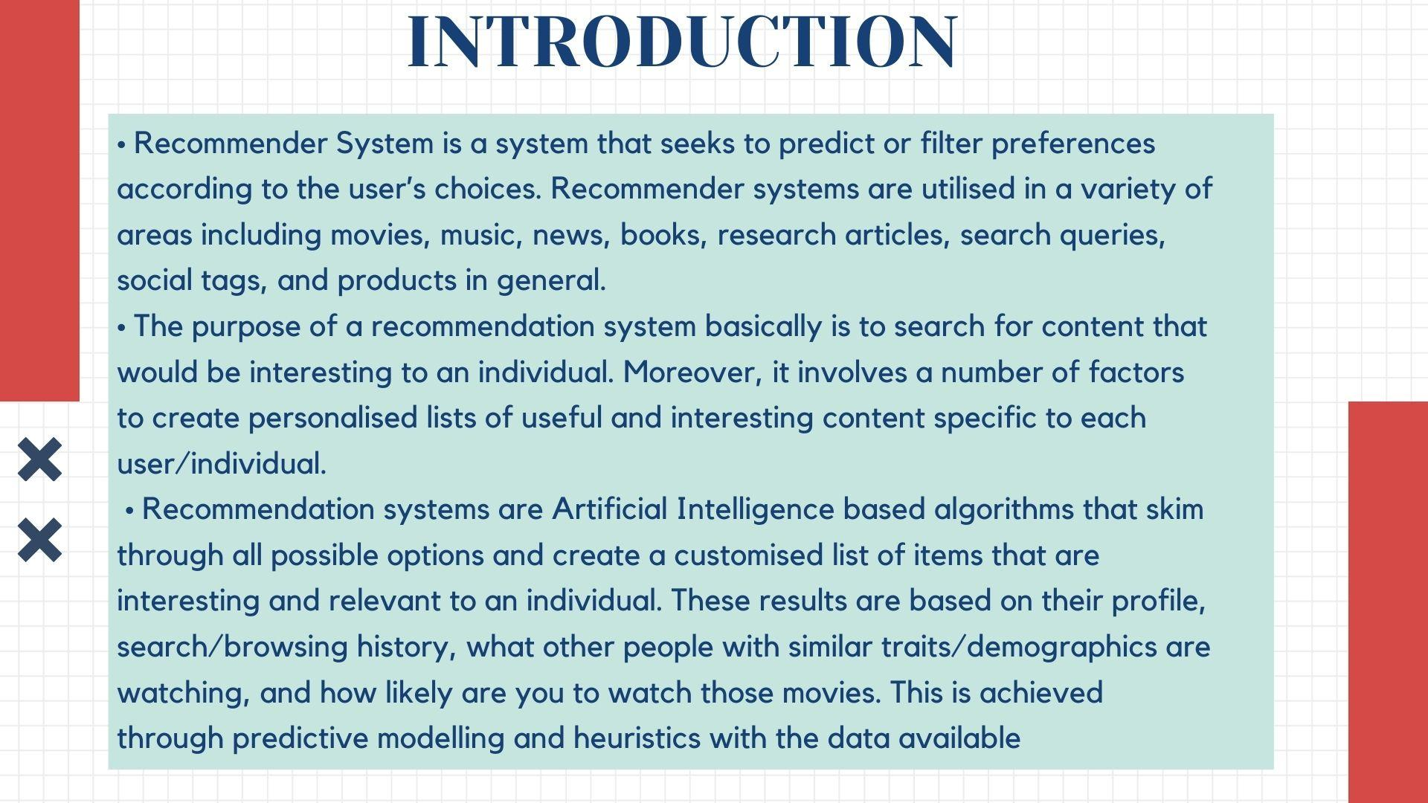
INTRODUCTION
(Permanently Affiliated to University of Mumbai)
Recommender System is a system that seeks to predict or filter preferences according to the user’s choices. Recommender systems are utilised in a variety of areas including movies, music, news, books, research articles, search queries, social tags, and products in general.
The purpose of a recommendation system basically is to search for content that would be interesting to an individual. Moreover, it involves a number of factors to create personalised lists of useful and interesting content specific to each user/individual.
Recommendation systems are Artificial Intelligence based algorithms that skim through all possible options and create a customised list of items that are interesting and relevant to an individual. These results are based on their profile, search/browsing history, what other people with similar traits/demographics are watching, and how likely are you to watch those movies. This is achieved through predictive modelling and heuristics with the data available.

Slide 4
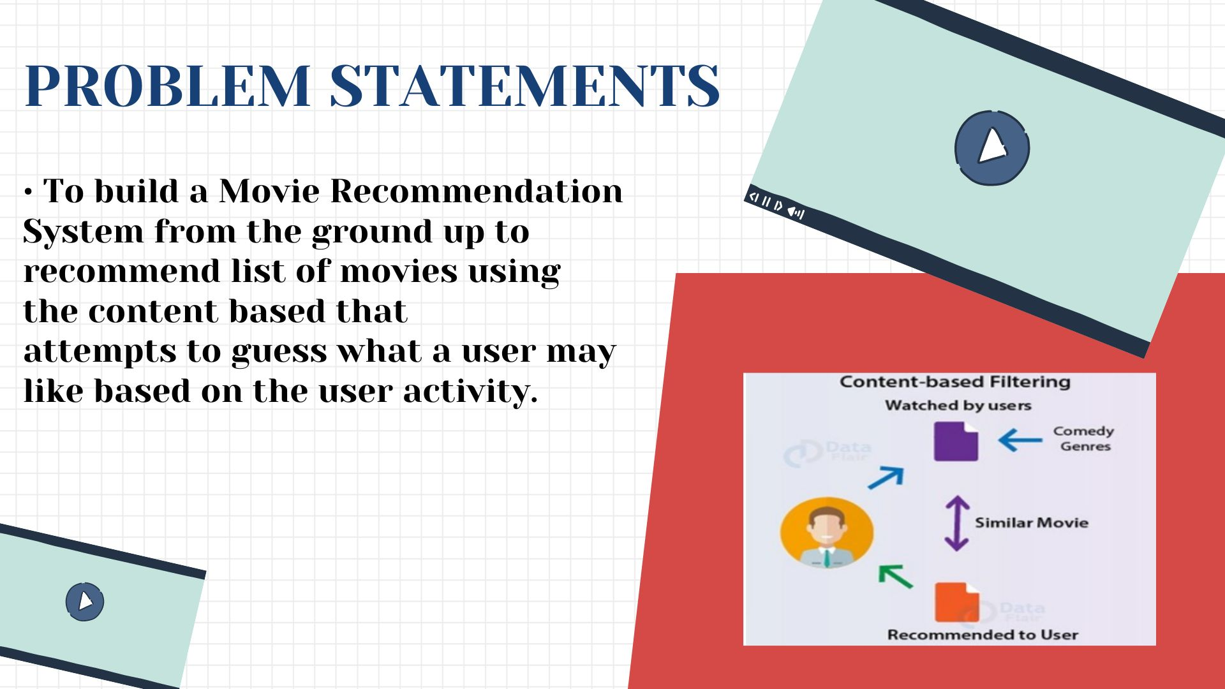
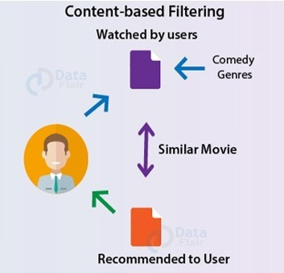
PROBLEM STATEMENTS
(Permanently Affiliated to University of Mumbai)
To build a Movie Recommendation System from the ground up to recommend list of movies using the content based that attempts to guess what a user may like based on the user activity.

Slide 5
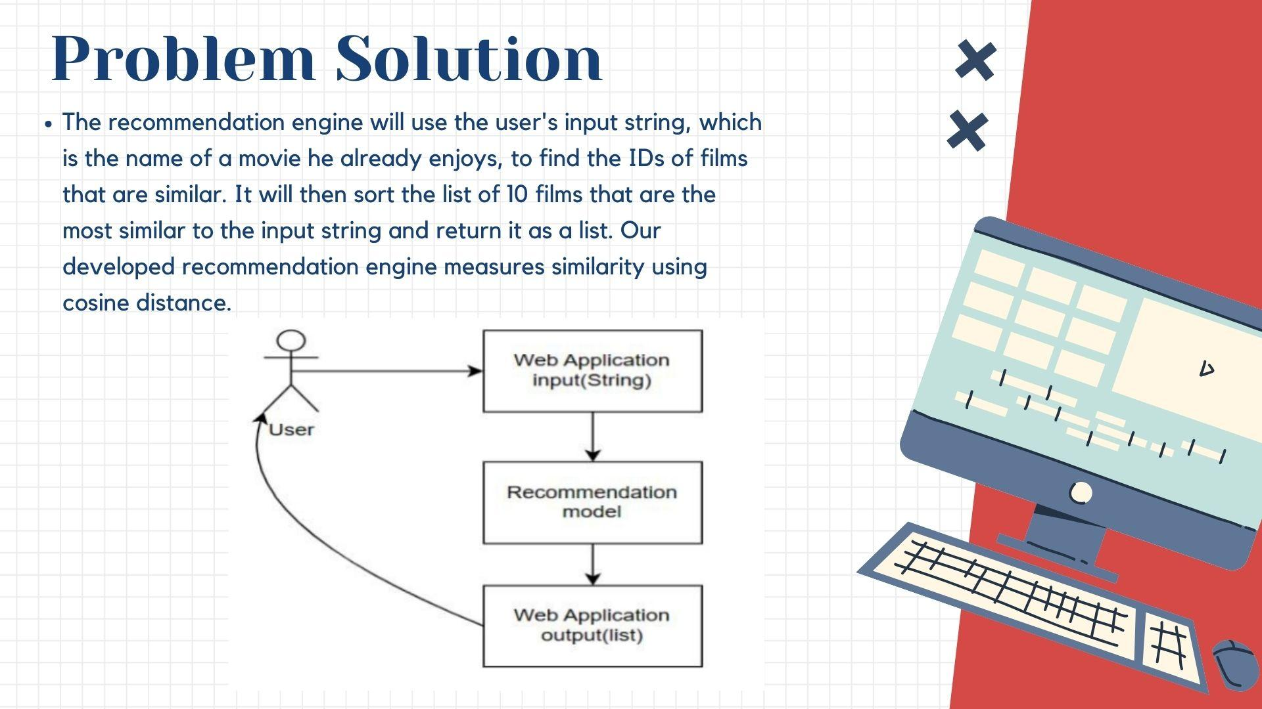
5

Slide 6
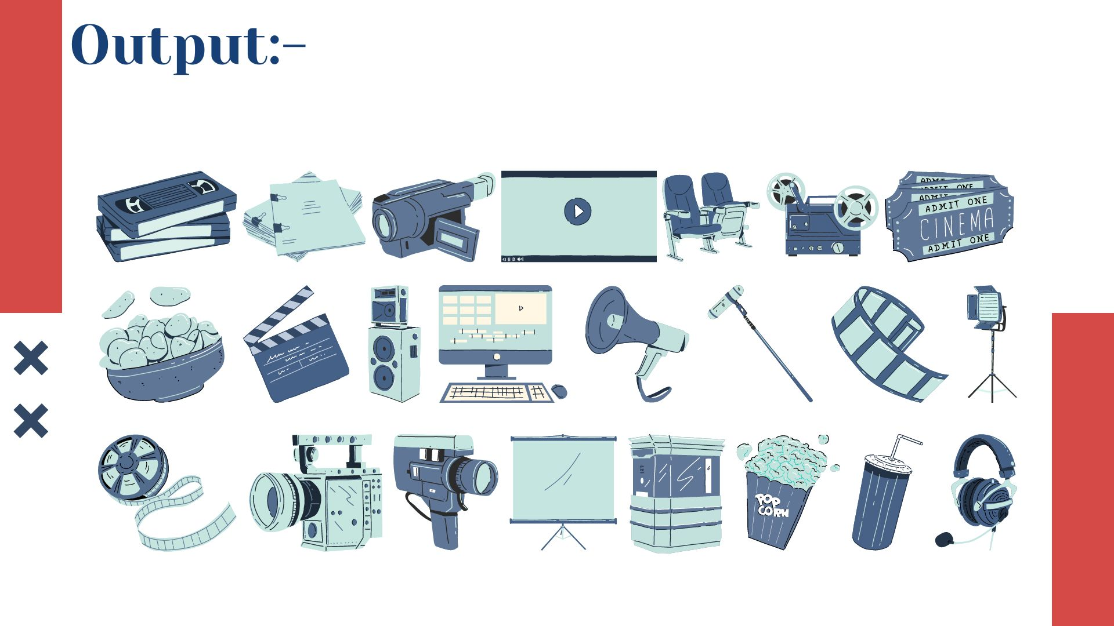
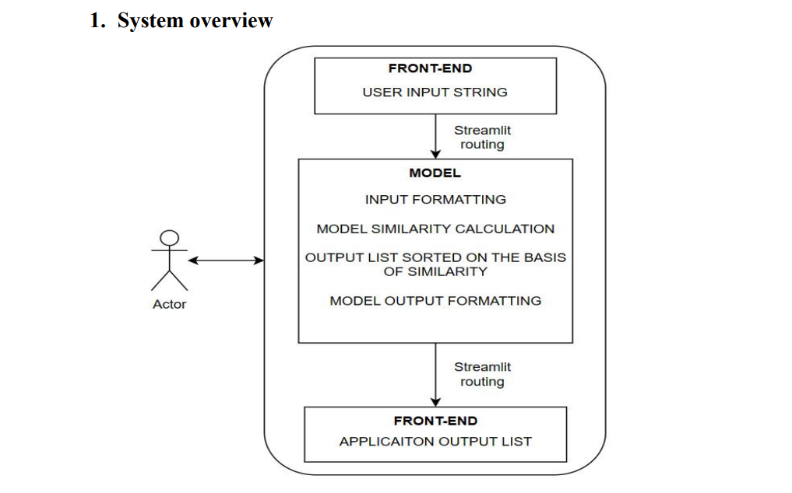

Slide 7
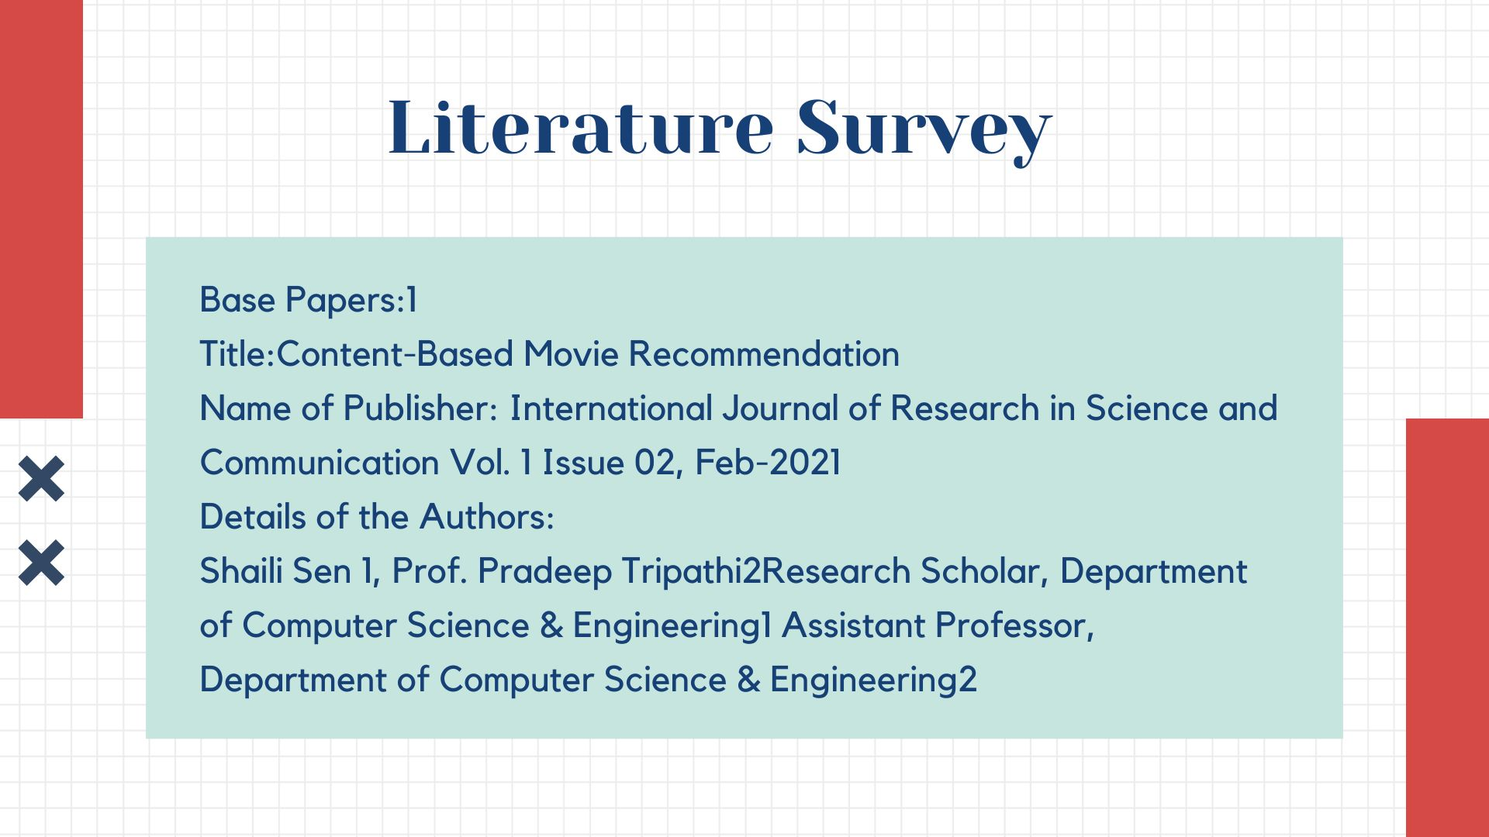

Slide 8
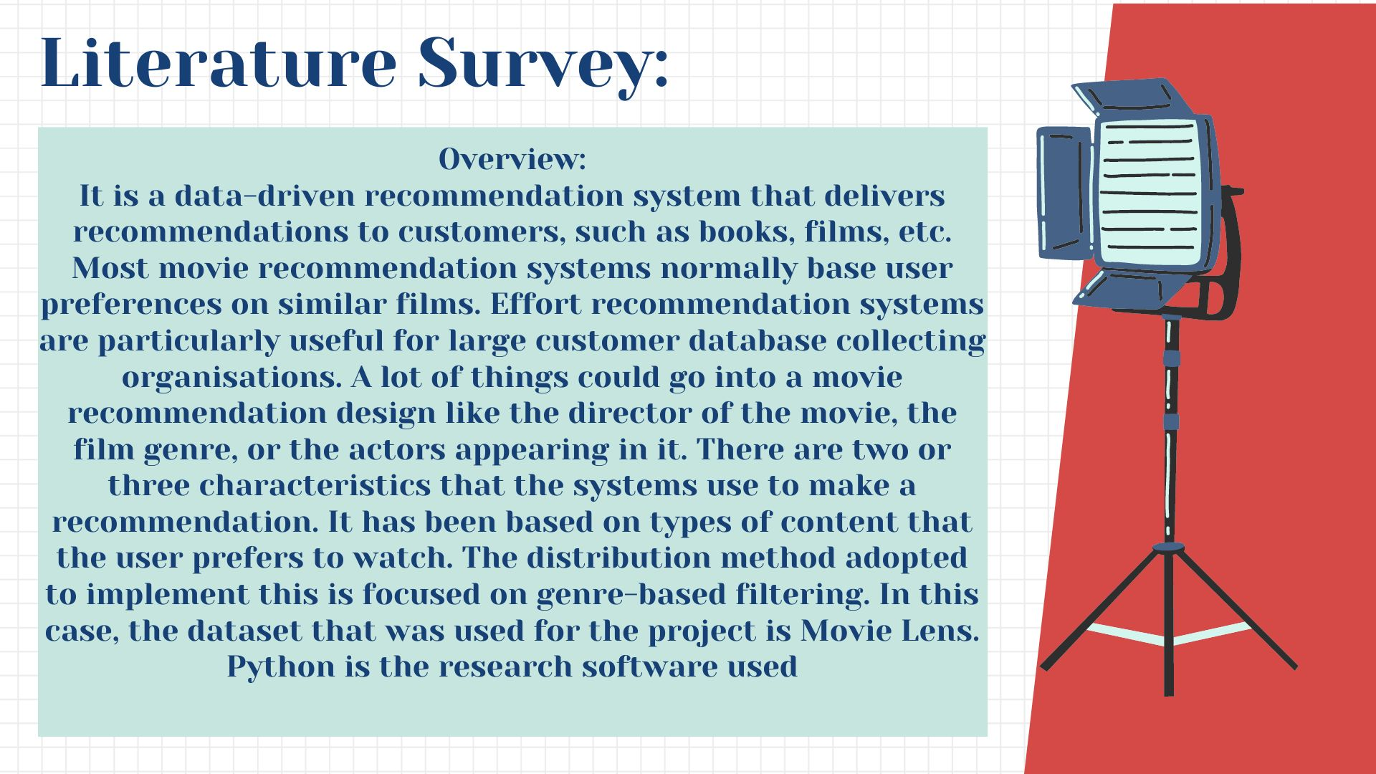

Slide 9
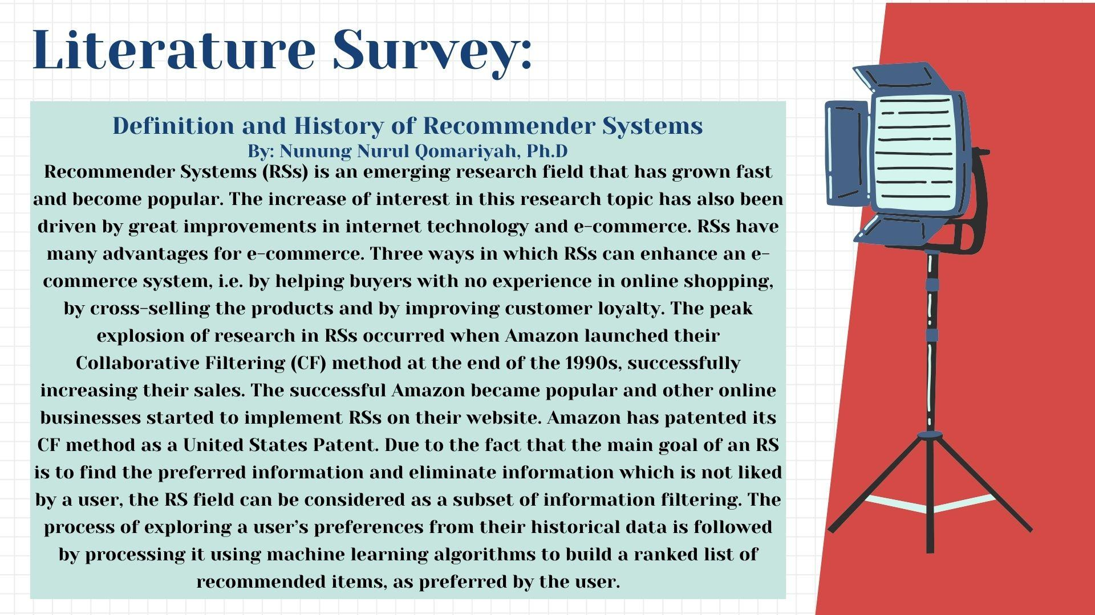

Slide 10
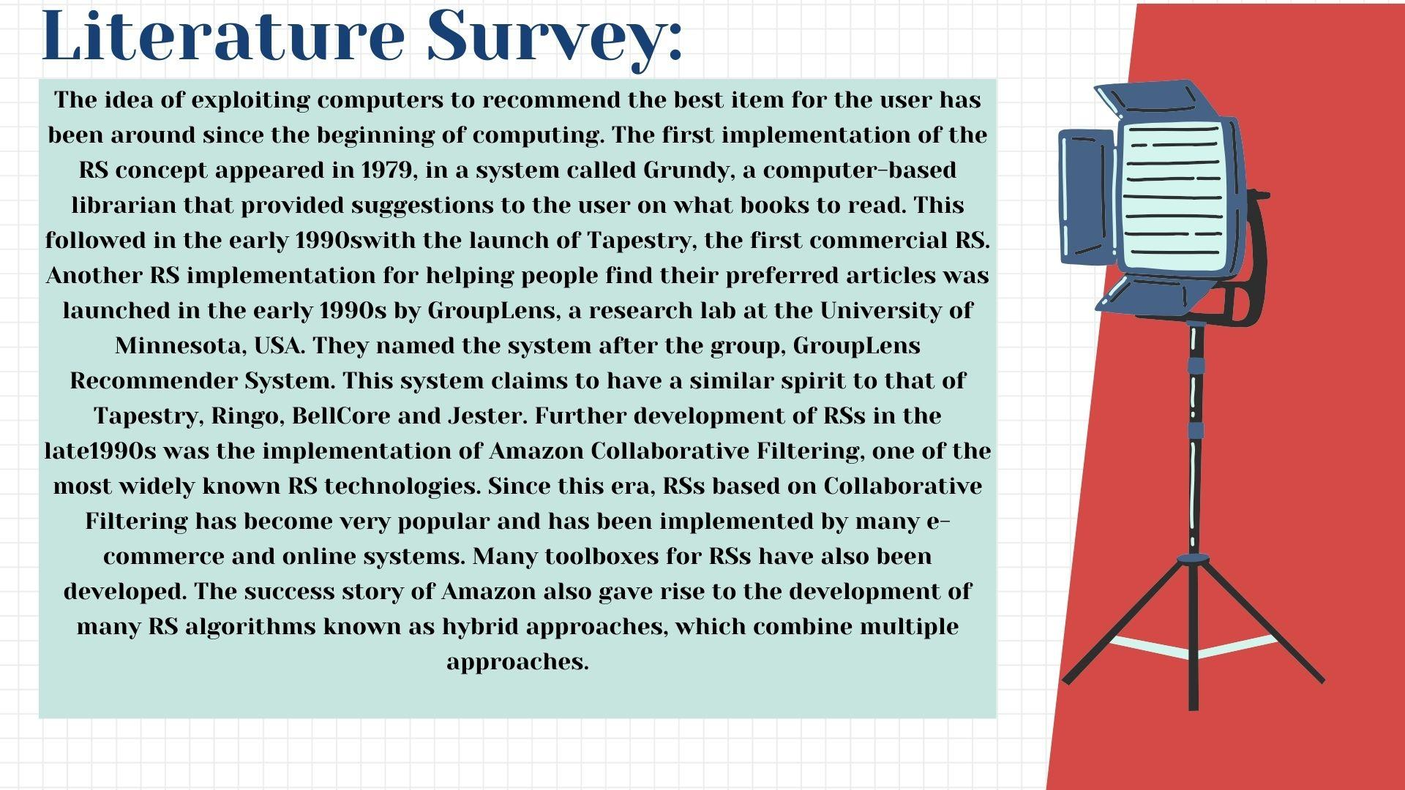

Slide 11
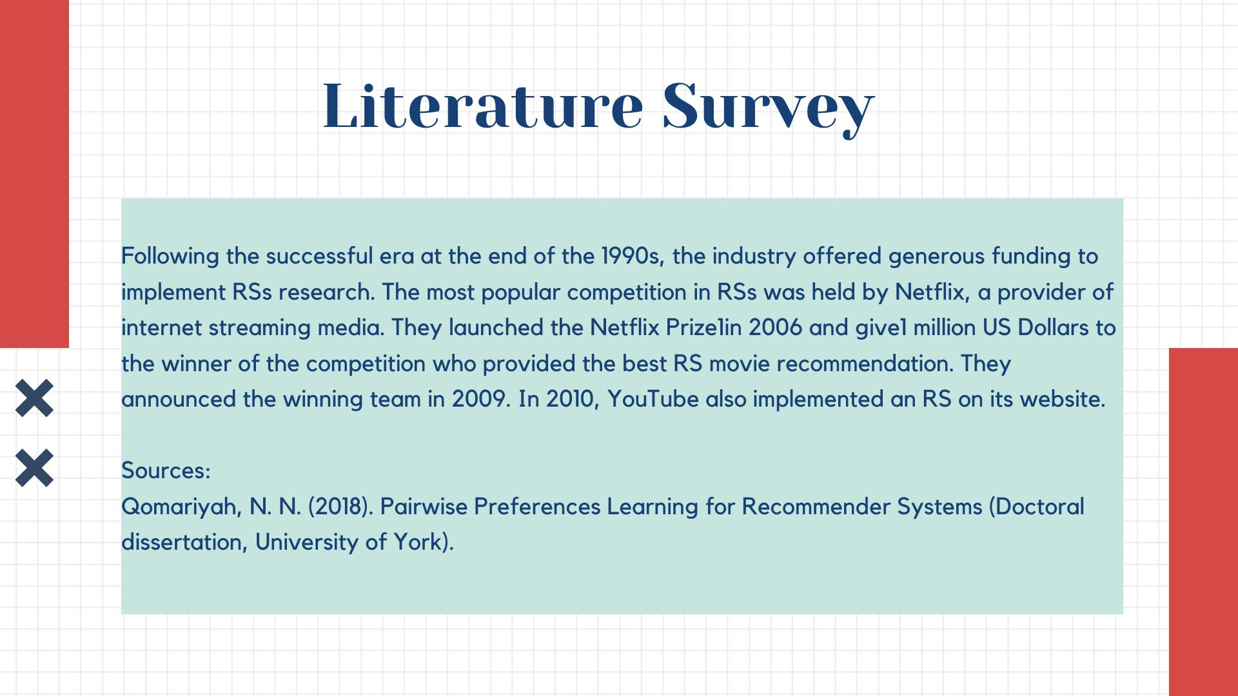

Slide 12
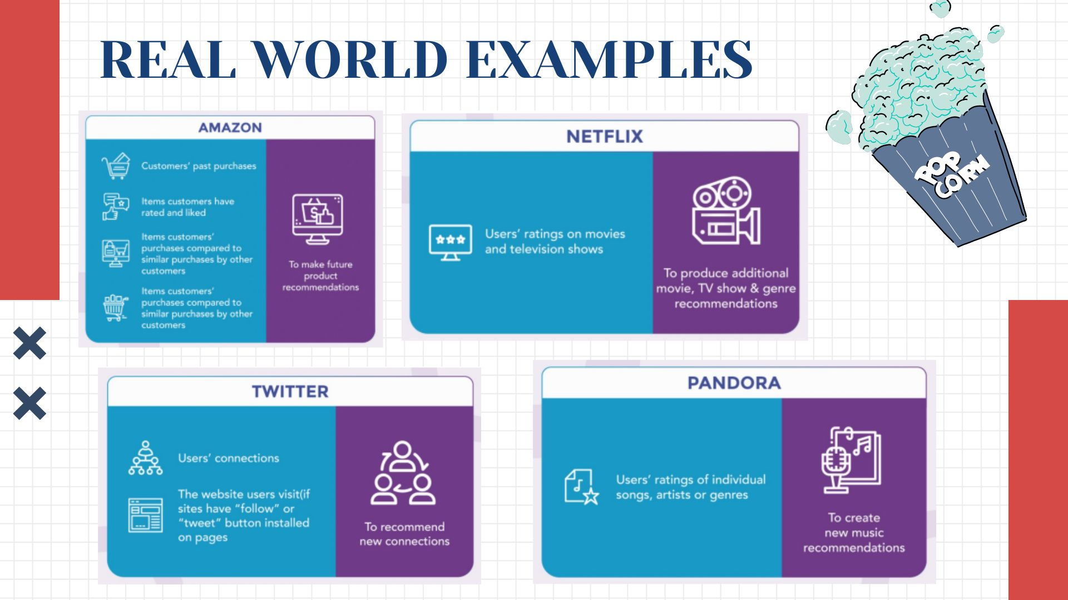
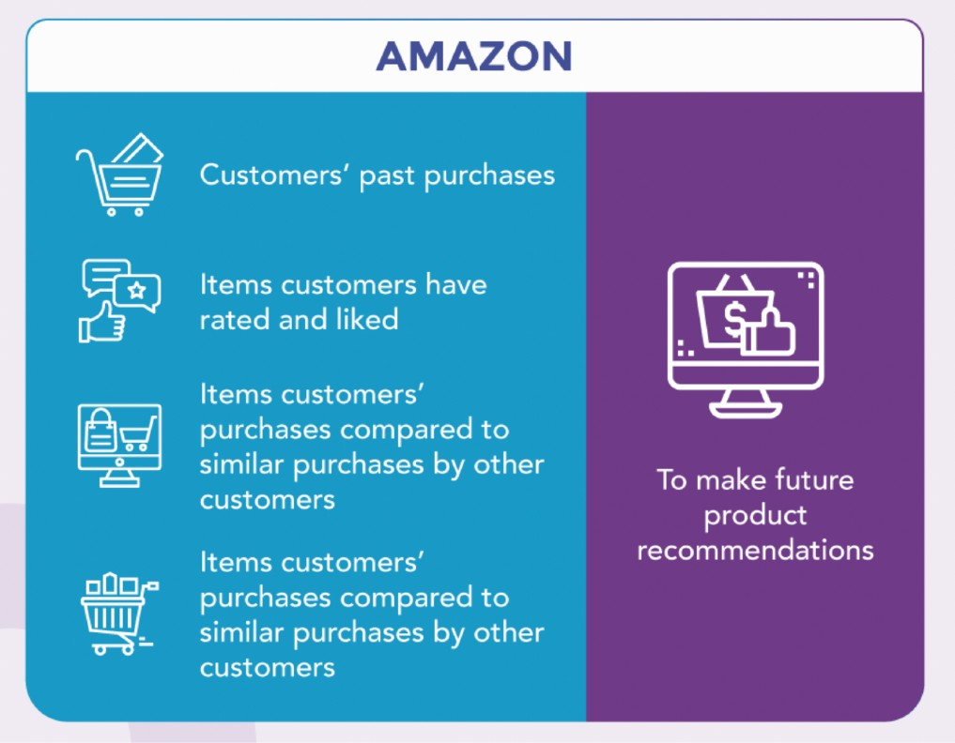
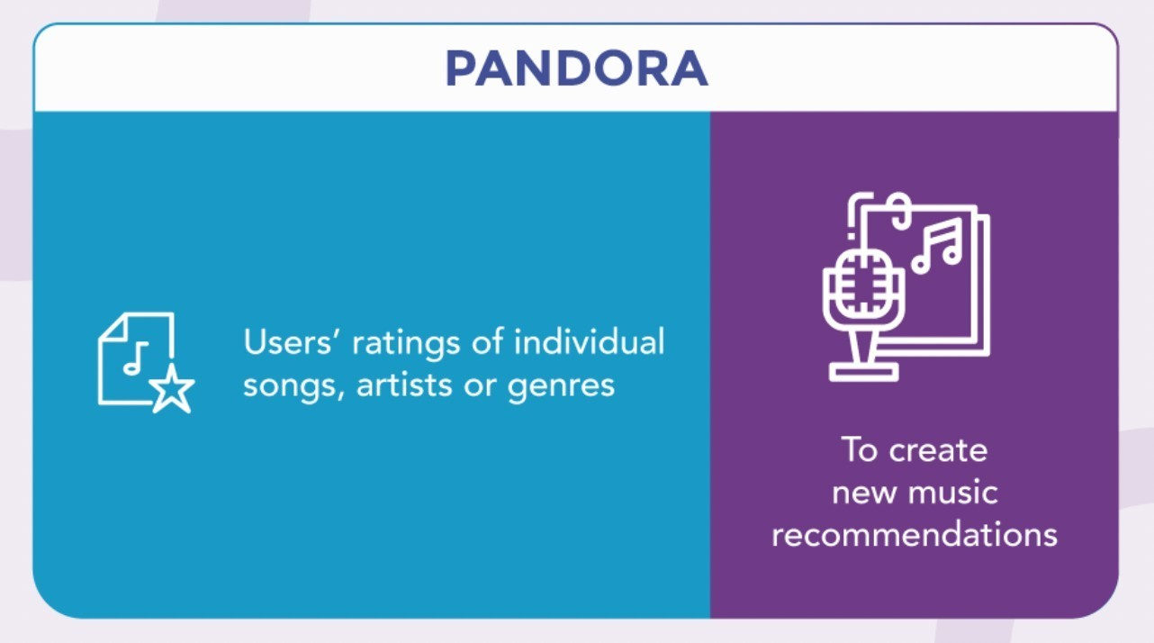
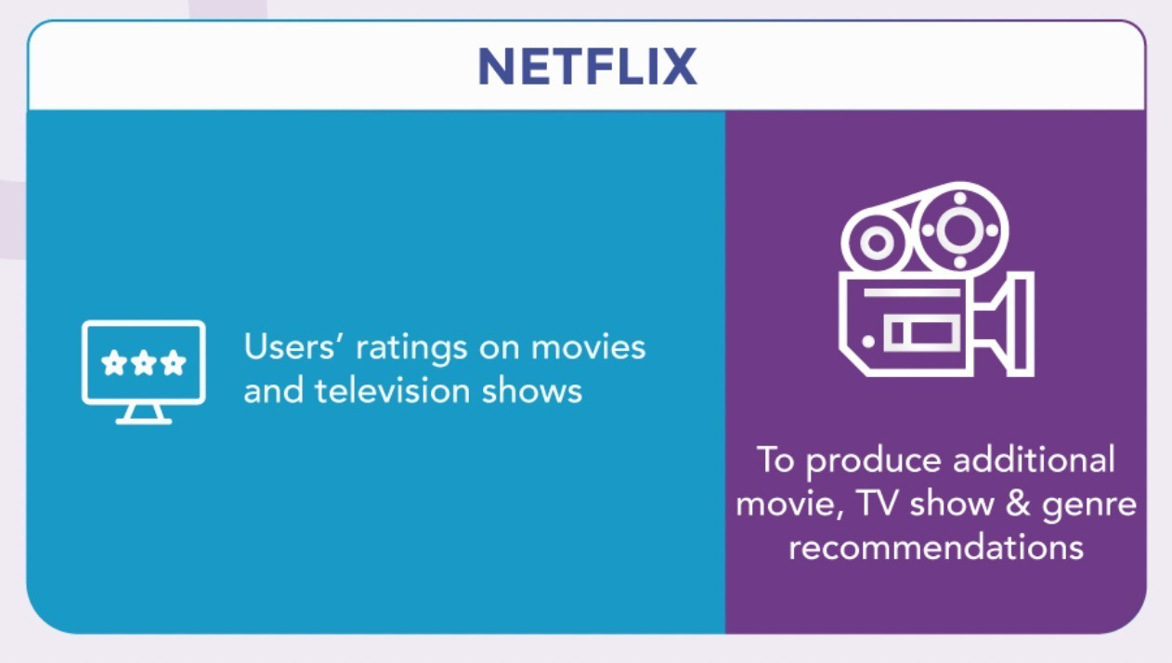
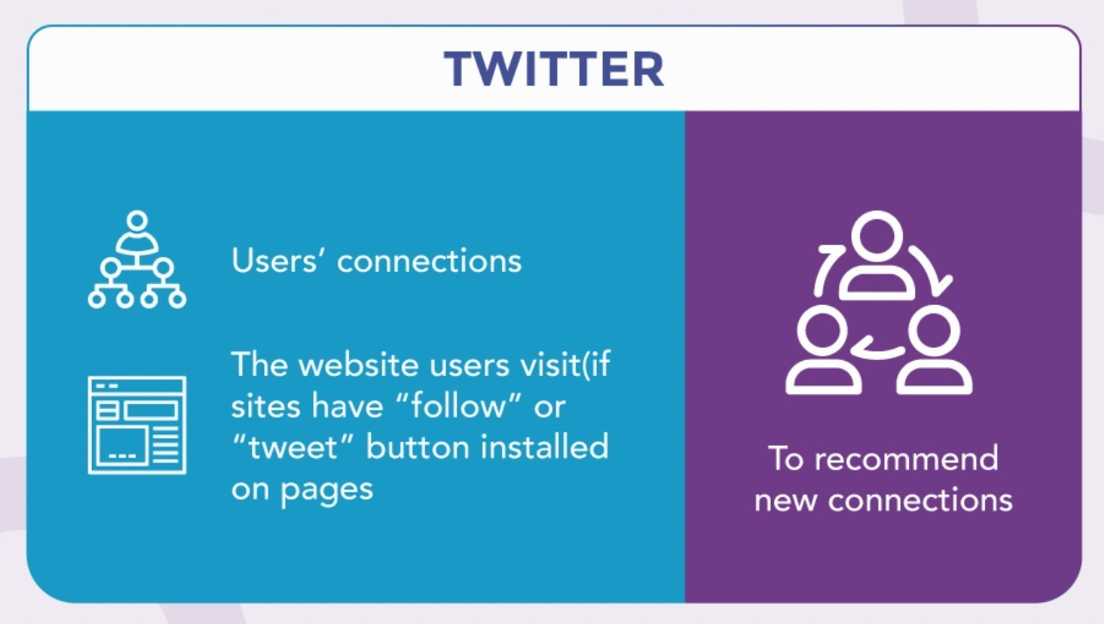
REAL WORLD EXAMPLE:
(Permanently Affiliated to University of Mumbai)

Slide 13
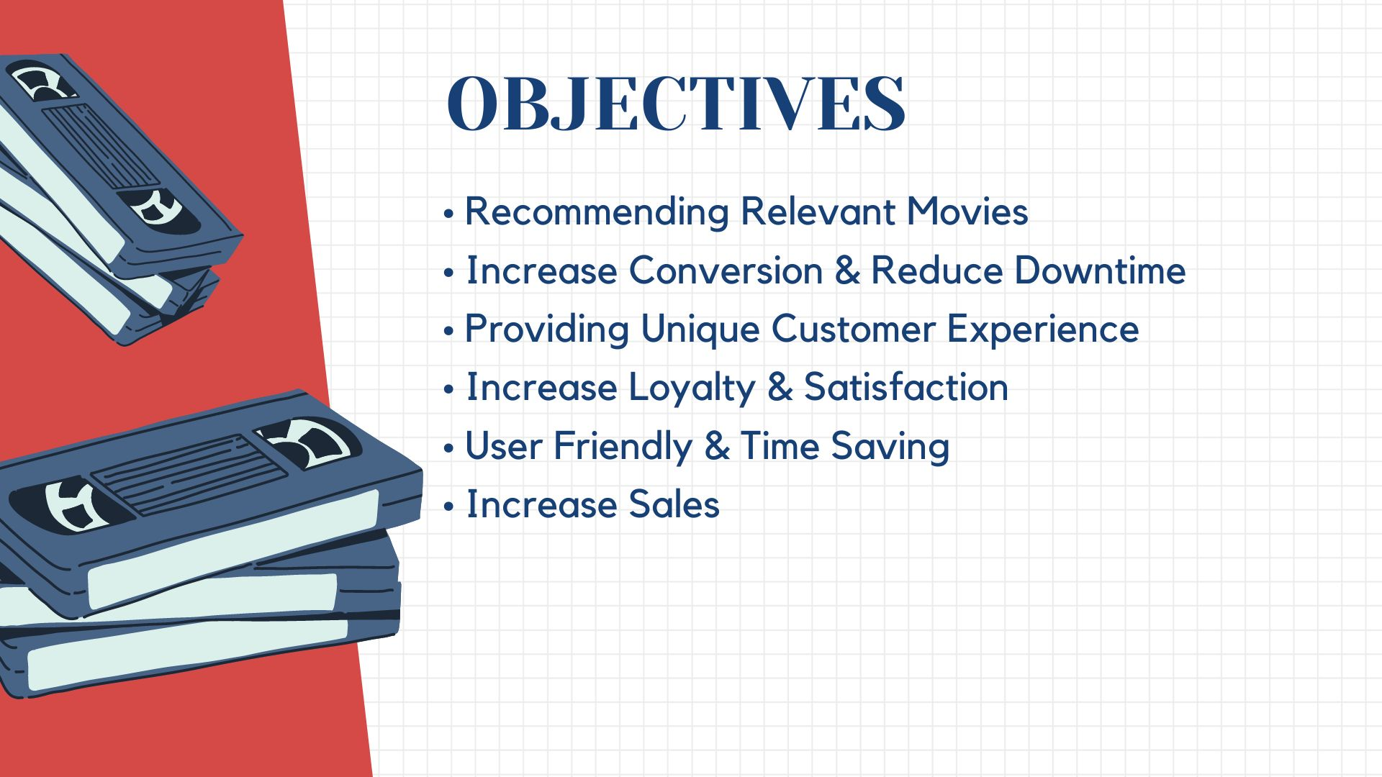

OBJECTIVES:
(Permanently Affiliated to University of Mumbai)
Recommending Relevant Movies
Increase Conversion & Reduce Downtime
Providing Unique Customer Experience
Increase Loyalty & Satisfaction
User Friendly & Time Saving
Increase Sales

Slide 14
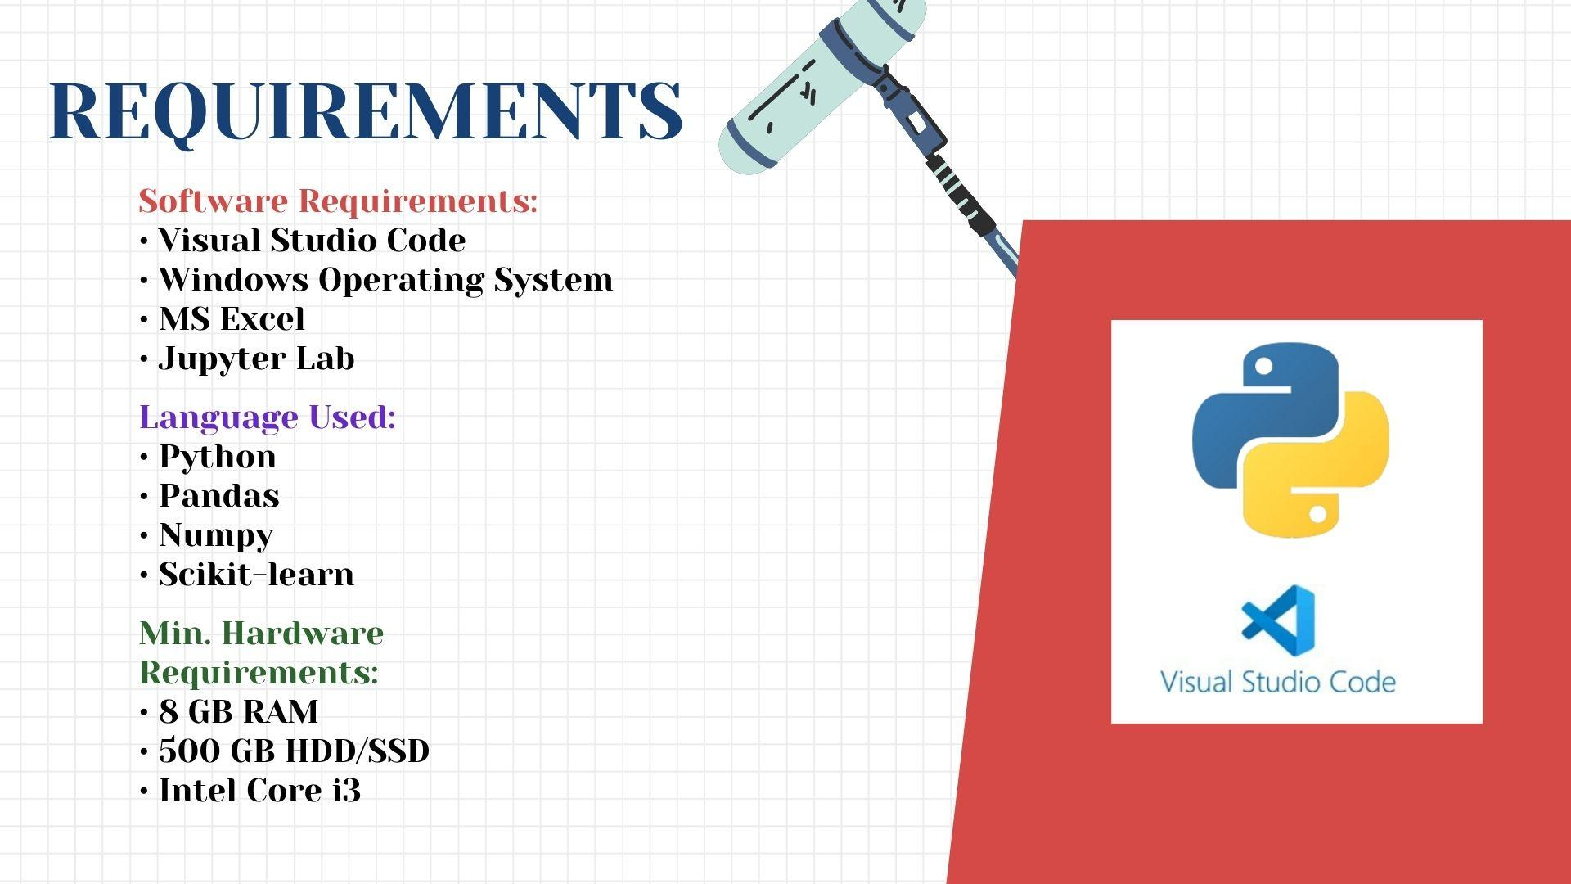


REQUIREMENTS
(Permanently Affiliated to University of Mumbai)
Software Requirements:
Visual Studio Code
Windows Operating
MS Excel
Jupyter Lab
System
Language Used:
Python
^{Pandas}
^{Numpy}
^{Scikit-learn}
Min. Hardware Requirements:
8 GB RAM
500 GB HDD/SSD
Intel Core i3

Slide 15
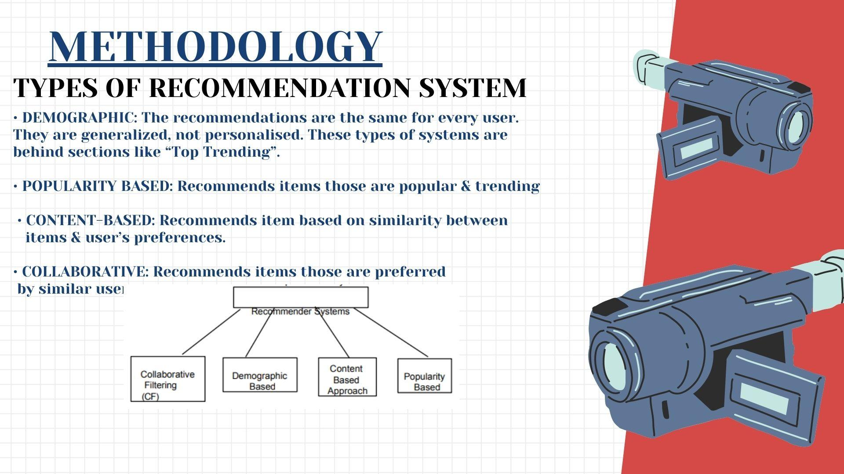
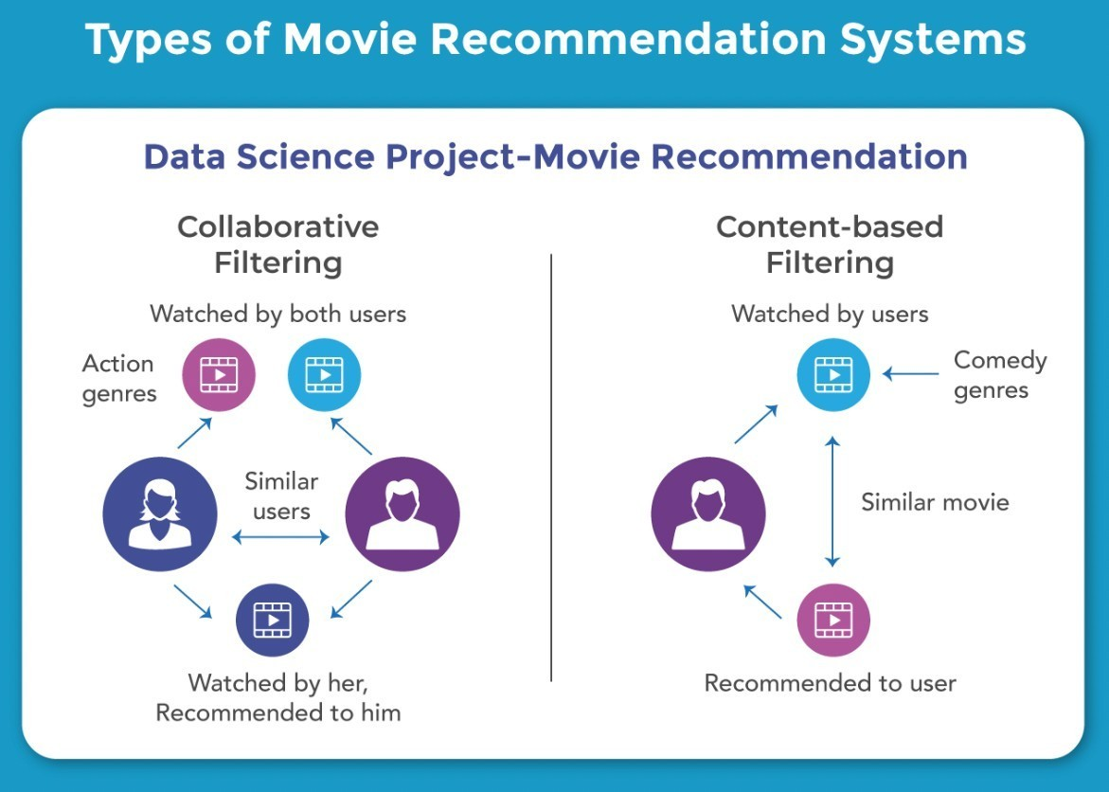
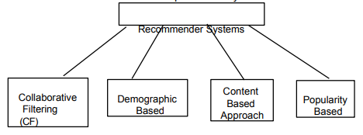
METHODOLOGY
(Permanently Affiliated to University of Mumbai)
TYPES OF RECOMMENDATION SYSTEM
DEMOGRAPHIC:
The recommendations are the same for every user. They are generalized, not personalised. These types of systems are behind sections like “Top Trending”.
POPULARITY BASED:
Recommends items those are popular & trending
CONTENT-BASED:
Recommends item based on similarity between items & user’s preferences.
COLLABORATIVE:
Recommends items those are preferred by similar users.
Recommender Systems
Collaborative Filtering
(CF)
Demographic
Based
Content Based Approach
Popularity Based

Slide 16
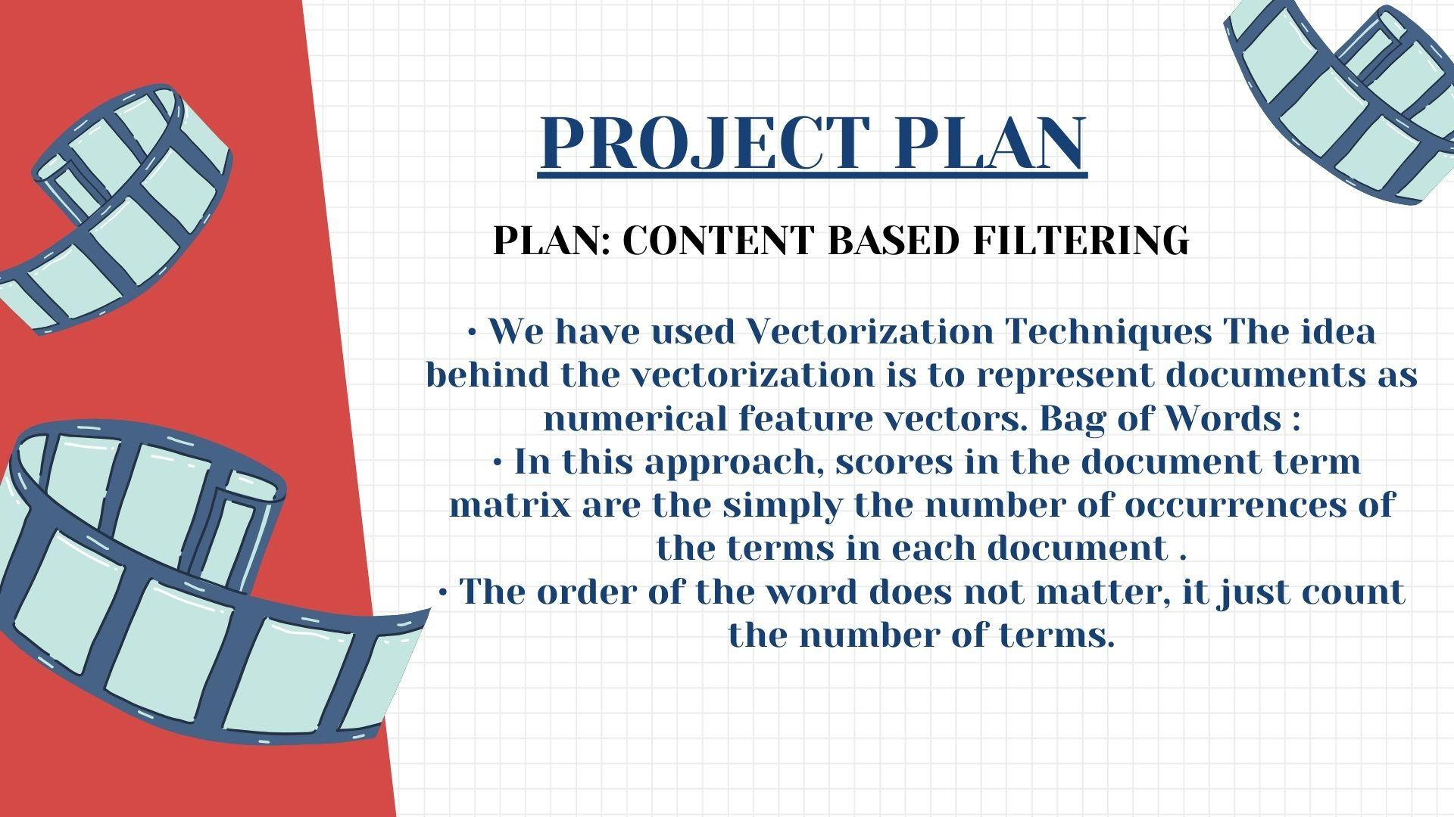
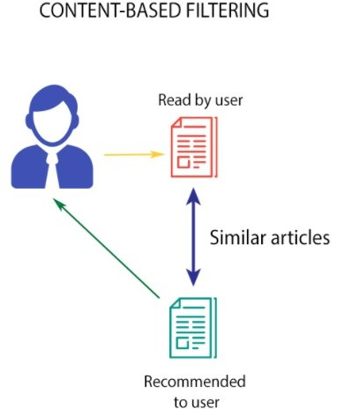
PROJECT
C_{P}O_{L}N_{A}TE_{N}N:T BASED FILTERING
(Permanently Affiliated to University of Mumbai)
We have used Vectorization Techniques
The idea behind the vectorization is to represent documents as
numerical feature vectors.
Bag of Words :
In this approach, scores in the document term matrix are the simply the number of occurrences of
the terms in each document .
The order of the word does not matter, it just count the number of terms.
•

Slide 17
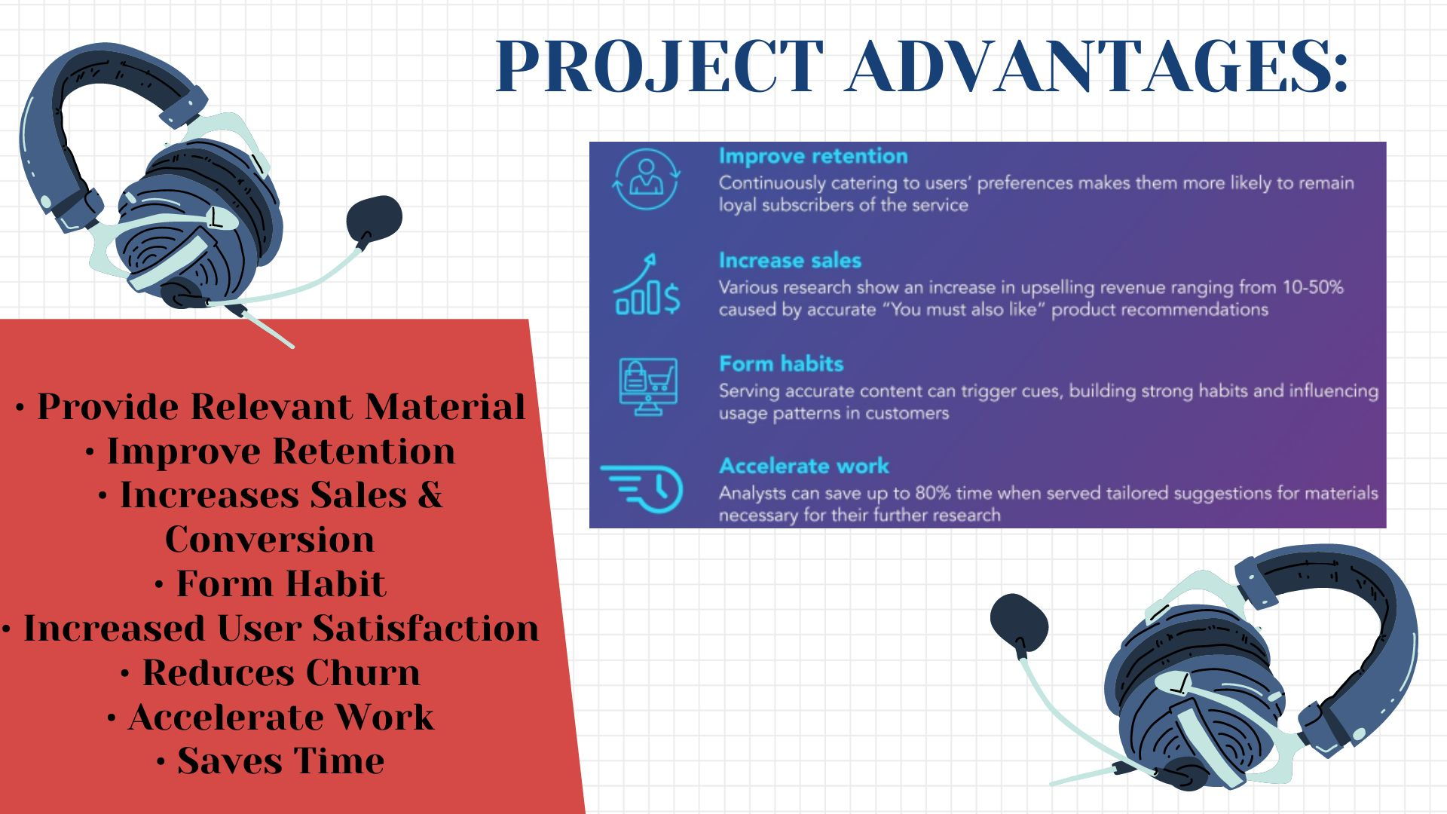
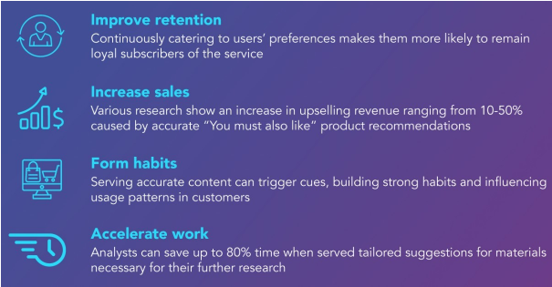
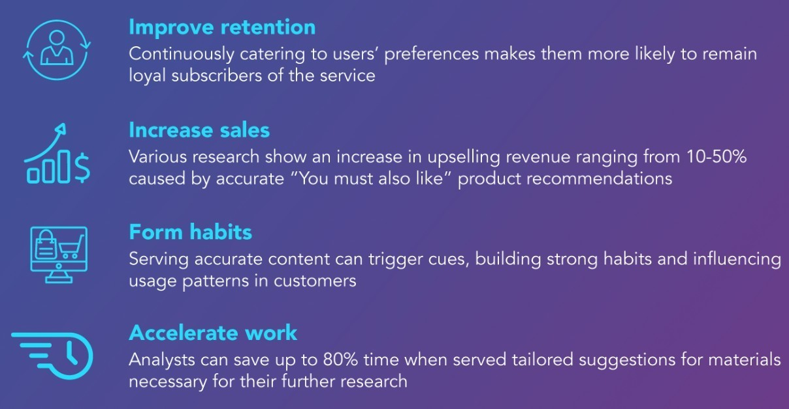
PROJECT ADVANTAGES:
(Permanently Affiliated to University of Mumbai)
Provide Relevant Material
Improve Retention
Increases Sales & Conversion
Form Habit
Increased User Satisfaction
Reduces Churn
Accelerate Work
Saves Time

Slide 18
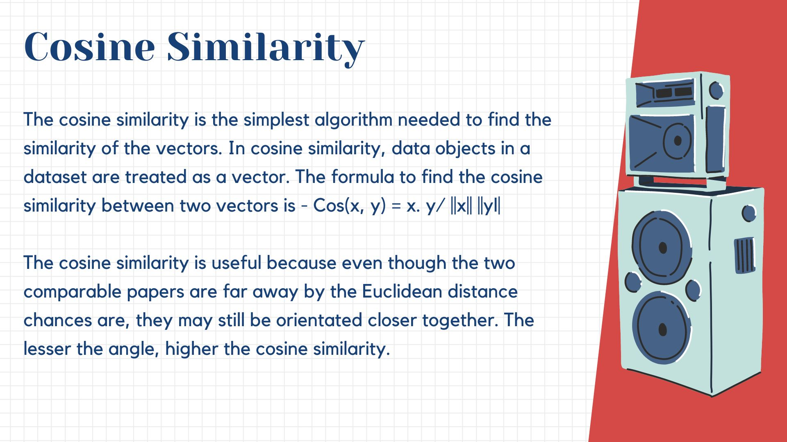

Slide 19
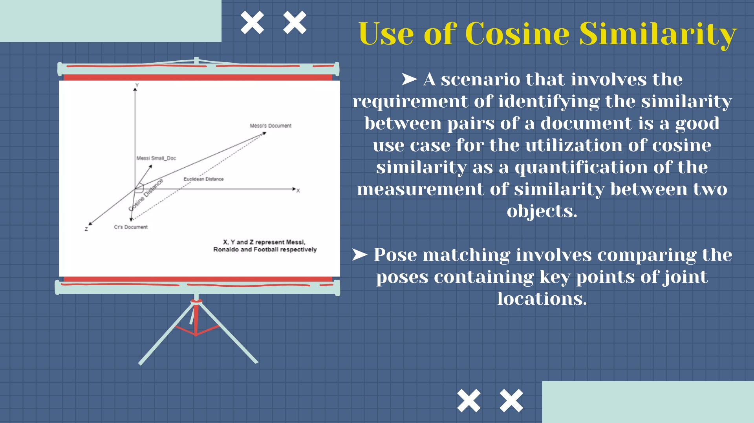

Slide 20
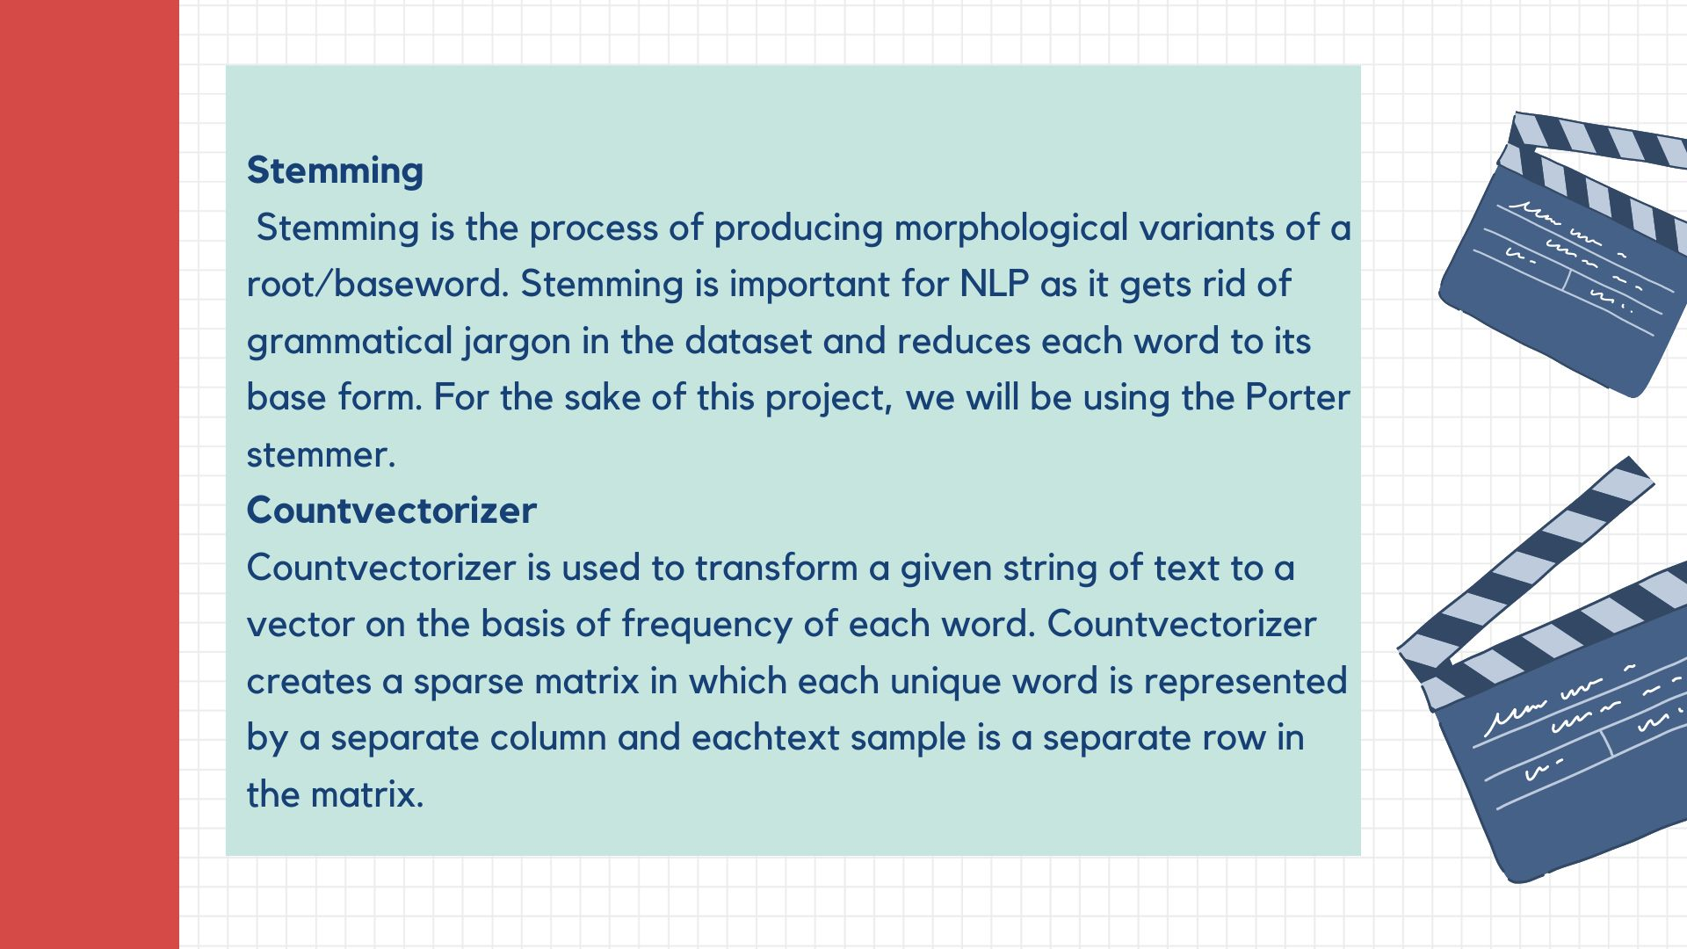

Slide 21
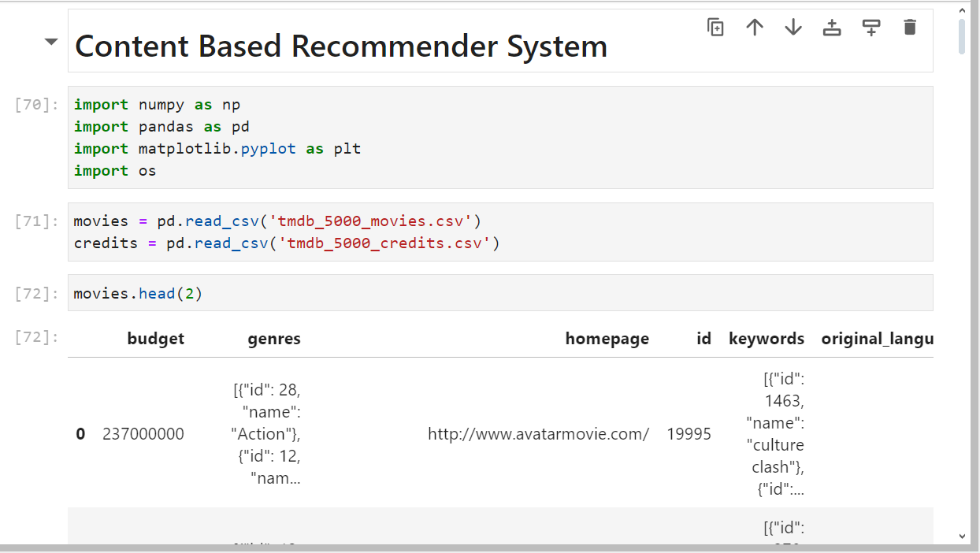
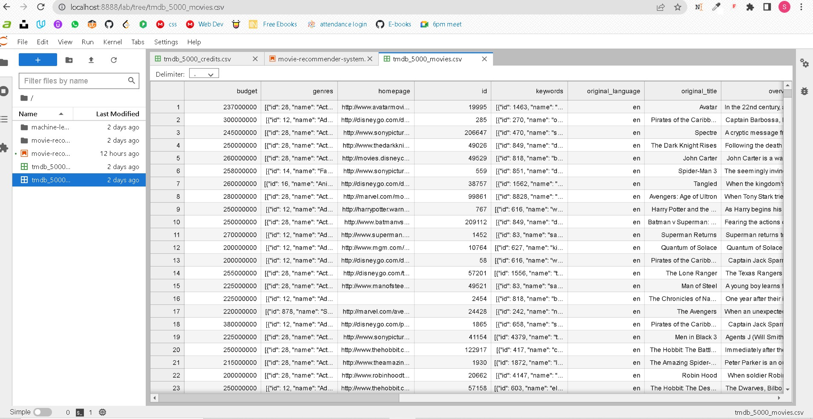
OUTPUT:
(Permanently Affiliated to University of Mumbai)

Slide 22
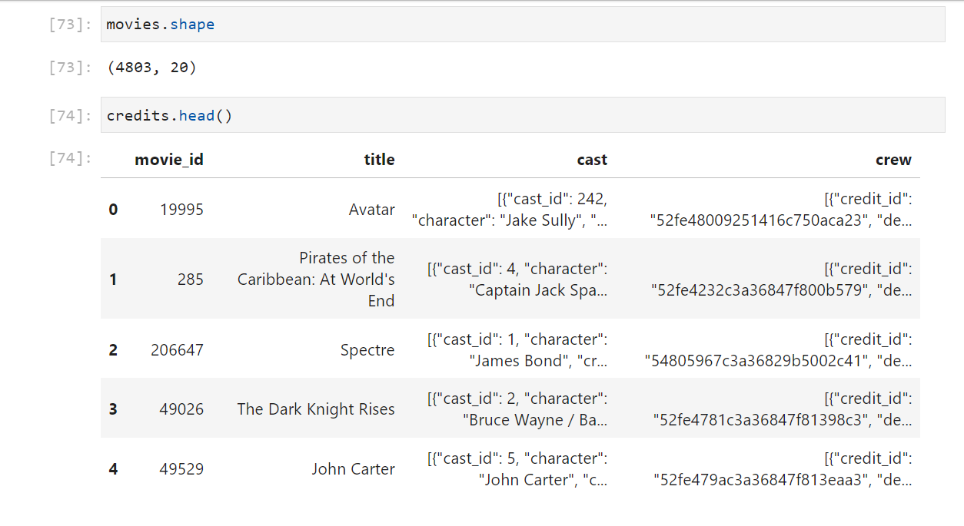
OUTPUT:
(Permanently Affiliated to University of Mumbai)

Slide 23
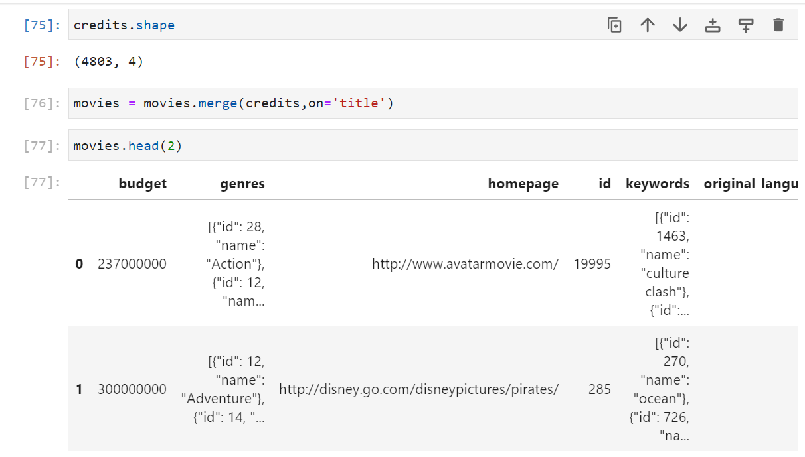
OUTPUT:
(Permanently Affiliated to University of Mumbai)

Slide 24
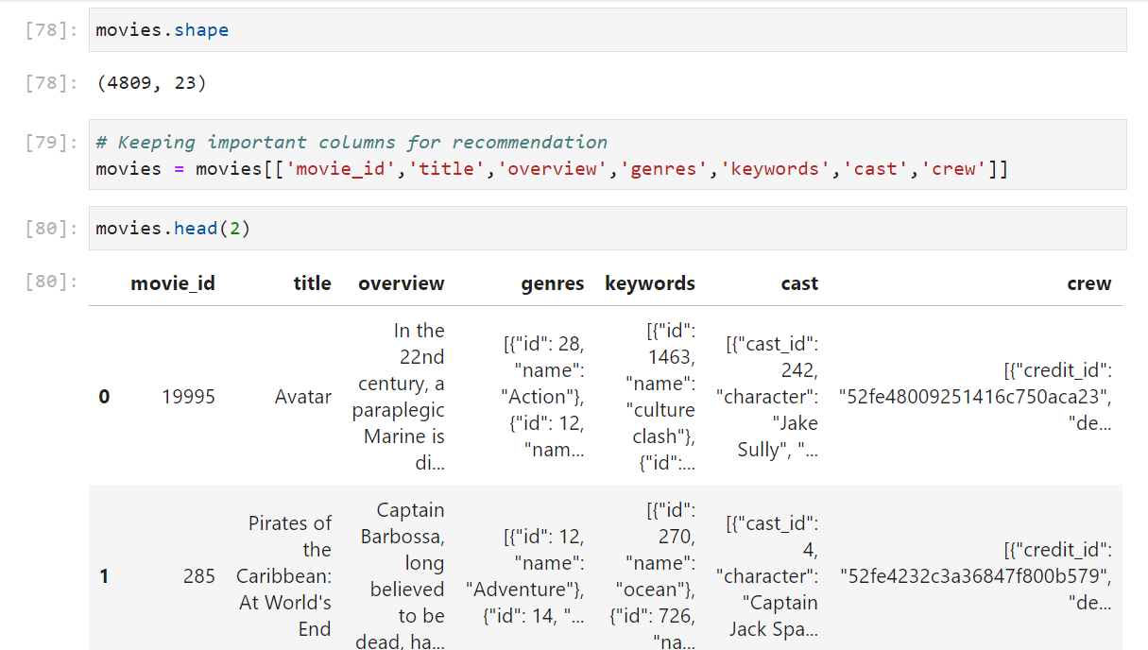
OUTPUT:
(Permanently Affiliated to University of Mumbai)

Slide 25
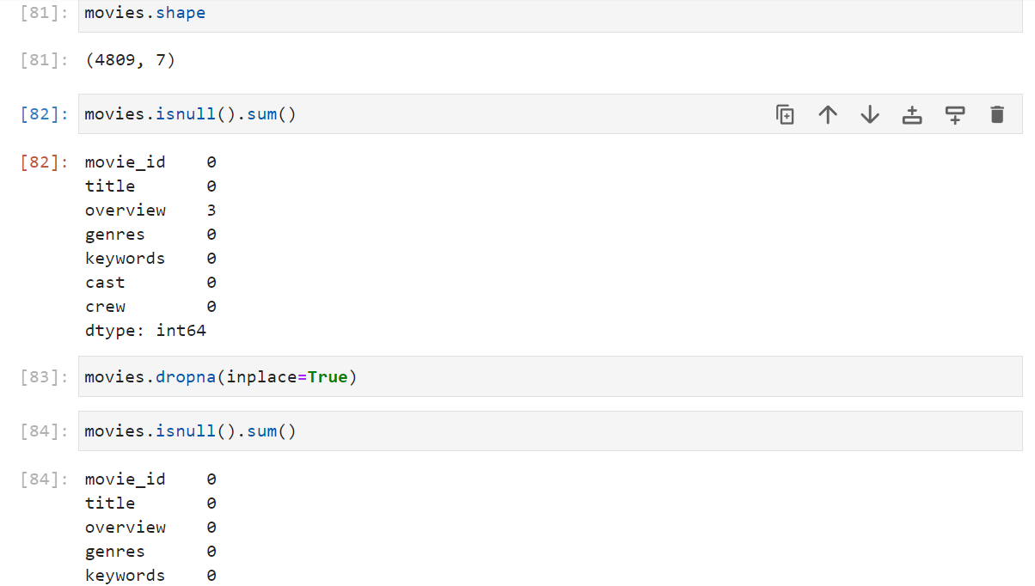
OUTPUT:
(Permanently Affiliated to University of Mumbai)

Slide 26
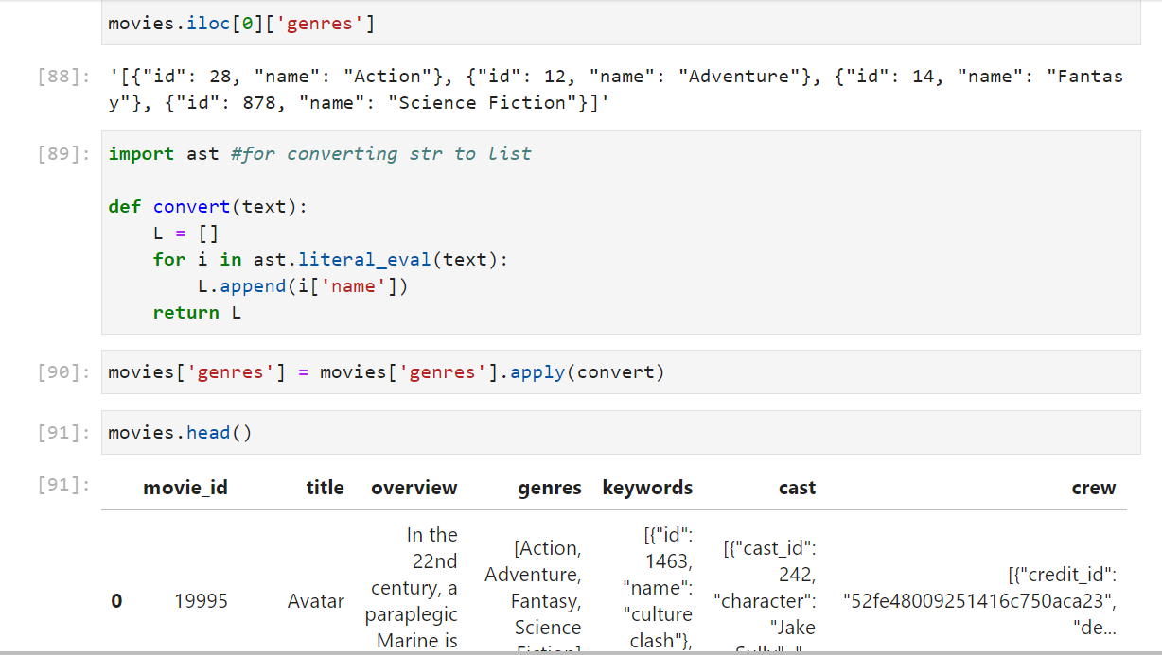
OUTPUT:
(Permanently Affiliated to University of Mumbai)

Slide 27
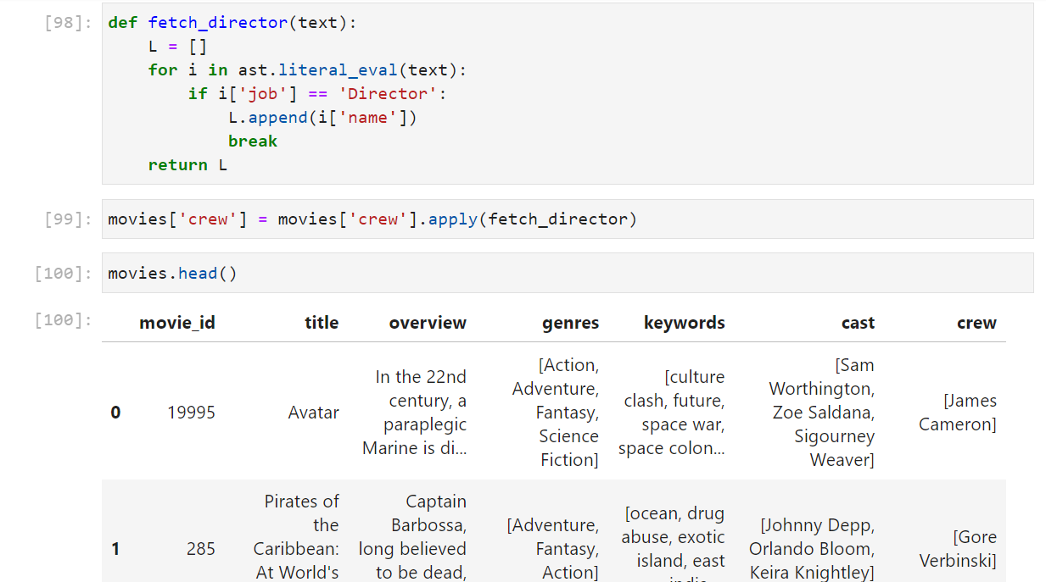
OUTPUT:
(Permanently Affiliated to University of Mumbai)

Slide 28
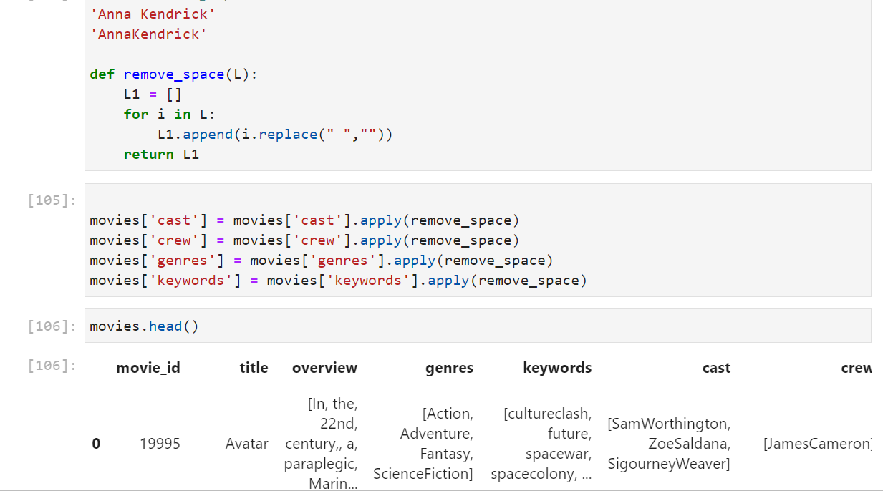
OUTPUT:
(Permanently Affiliated to University of Mumbai)

Slide 29
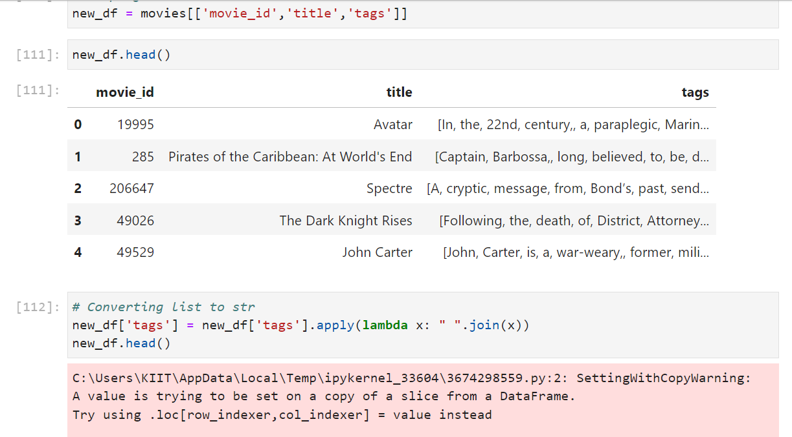
OUTPUT:
(Permanently Affiliated to University of Mumbai)

Slide 30
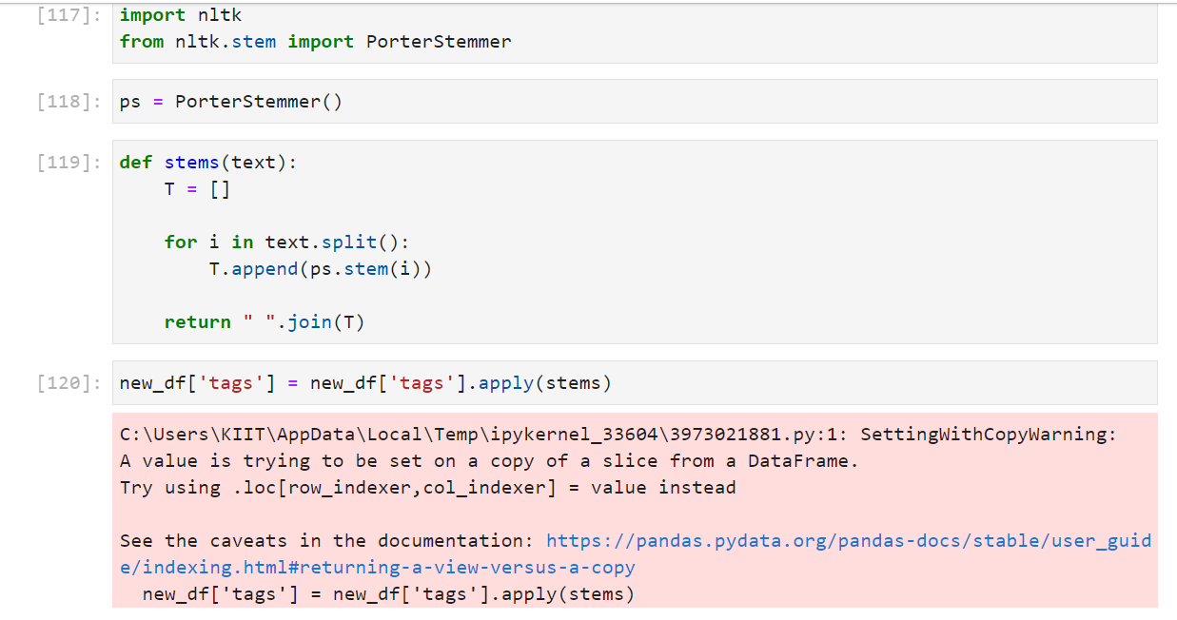
OUTPUT:
(Permanently Affiliated to University of Mumbai)

Slide 31
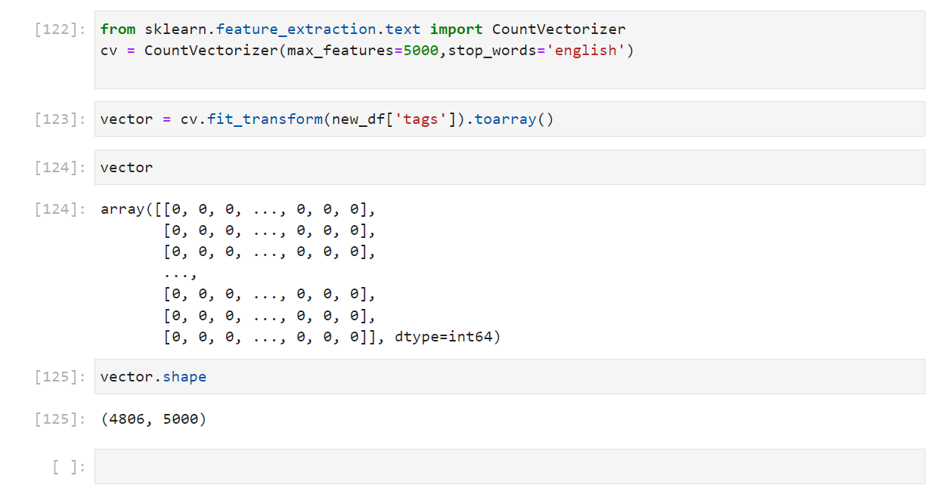
OUTPUT:
(Permanently Affiliated to University of Mumbai)

Slide 32
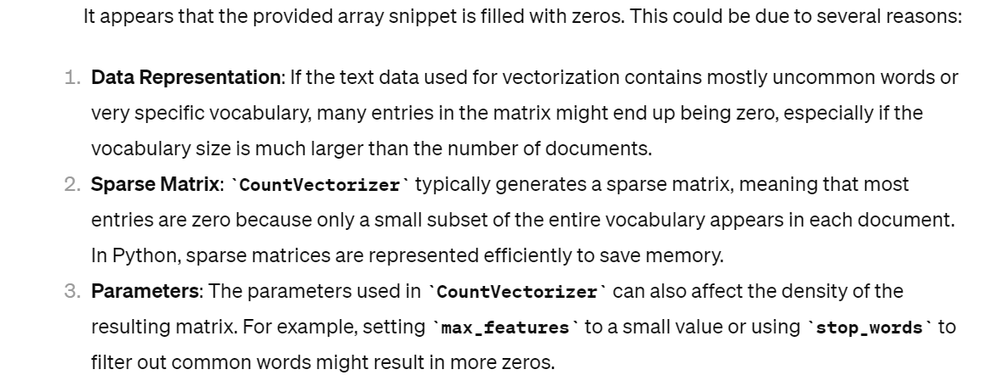

Slide 33
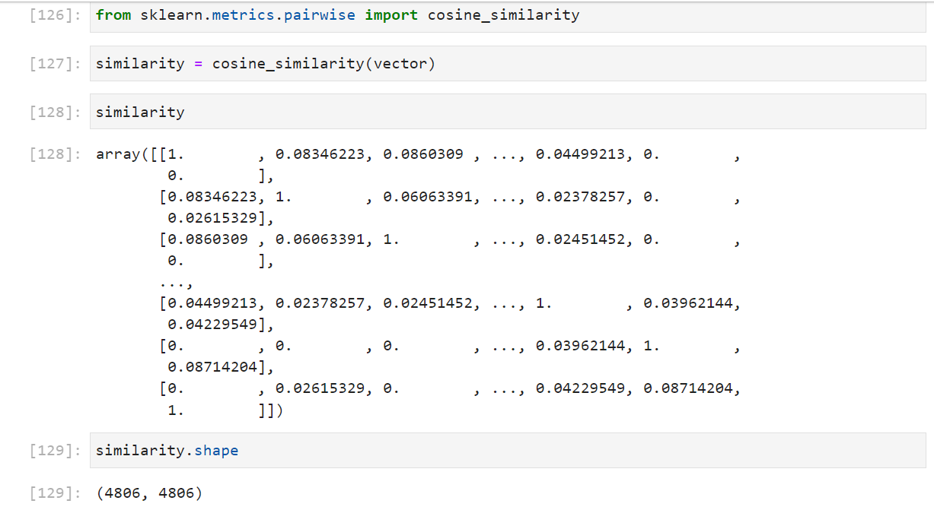
OUTPUT:
(Permanently Affiliated to University of Mumbai)

Slide 34
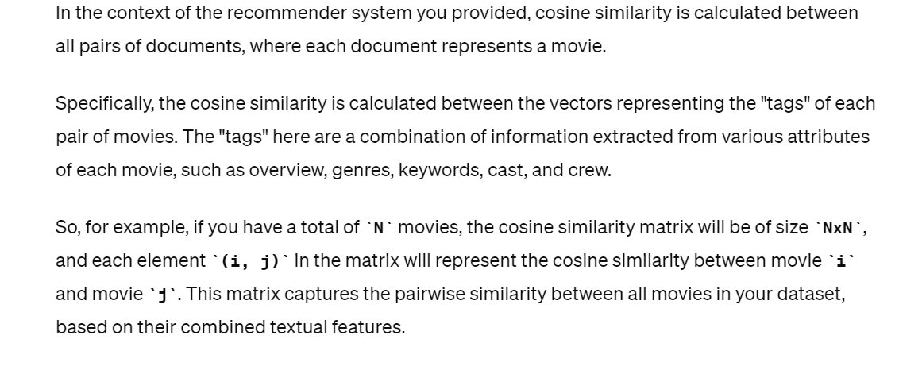

Slide 35
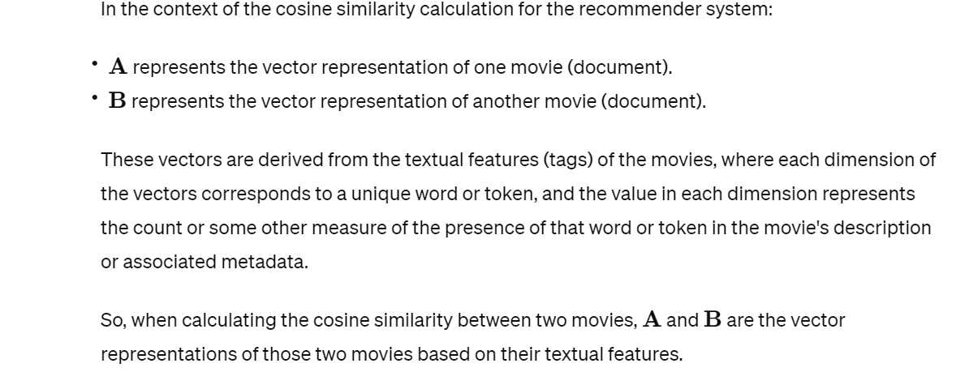

Slide 36
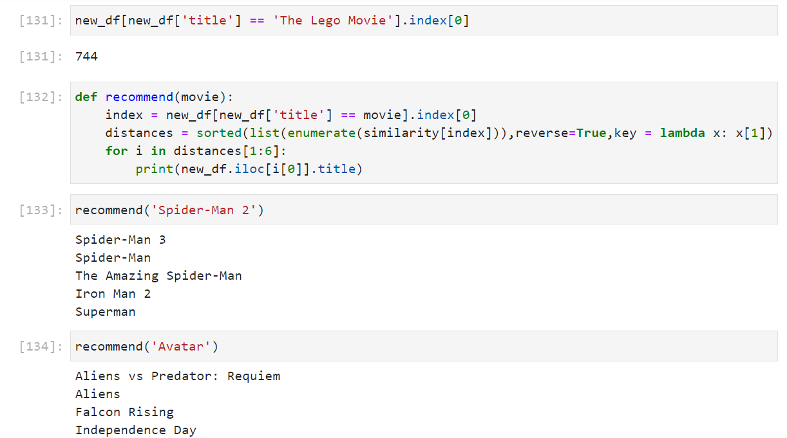
OUTPUT:
(Permanently Affiliated to University of Mumbai)

Slide 37
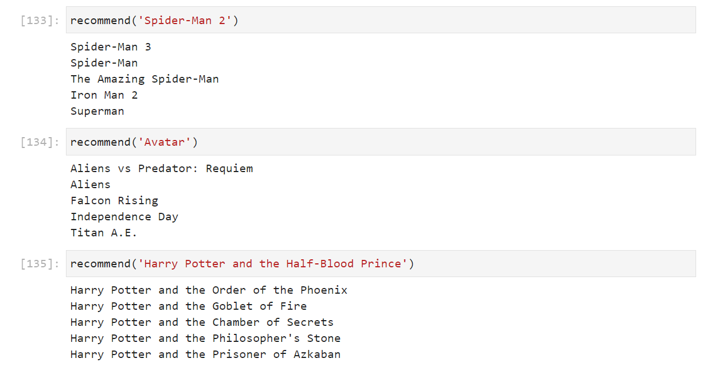
OUTPUT:
(Permanently Affiliated to University of Mumbai)

Slide 38
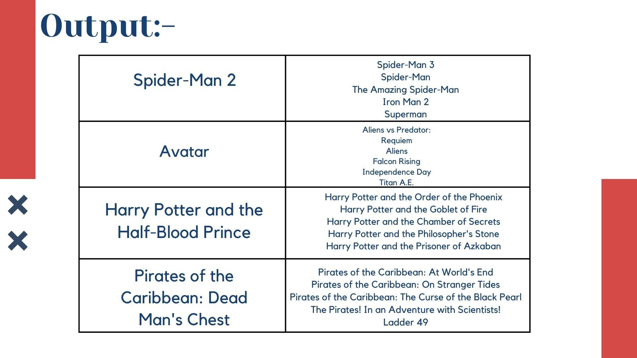

Slide 39



Slide 40


Slide 41


CONCLUSION:
(Permanently Affiliated to University of Mumbai)
Recommendation systems provide content for us by taking what other people recommend as well as our selections into account

Slide 42

CONCLUSION:
(Permanently Affiliated to University of Mumbai)
Recommendation systems provide content for us by taking what other people recommend as well as our selections into account

Slide 43

REFERENCES:
(Permanently Affiliated to University of Mumbai)
https://www.geeksforgeeks.or
g/python-implementation-of-movie- recommender-system/
https://www.mygr eatlearning.com/blog/masterclass-on-movie- recommendation-system/
https://data-flair.training/blogs/data-science-r-movie-
recommendation/
http://www.riejournal.com/ article_106395_c6c0038f1bf5d4c421bd552d0541d6be.pdf
Thank
You

